Slide 1
Regular Expressions
(Regex)

Slide 2
Two regex assignments given today
Two assginments, combined, will count as the “Lab 2“ score
An individual-based one, due in a week,
A group-based one, due in a week and a half
Find them in the “modules” area of canvas.
Eventually, I will weight each lab in this course equally. So don’t panic when you see that one of these is worth 100pts.

Slide 3
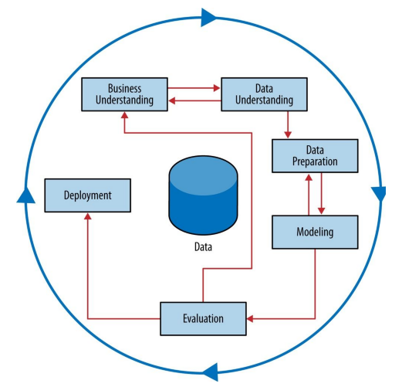

Slide 4
Now for Regex
What can you do with Regular expressions?
Anything you want to
Find text
Find and replace text

Slide 5
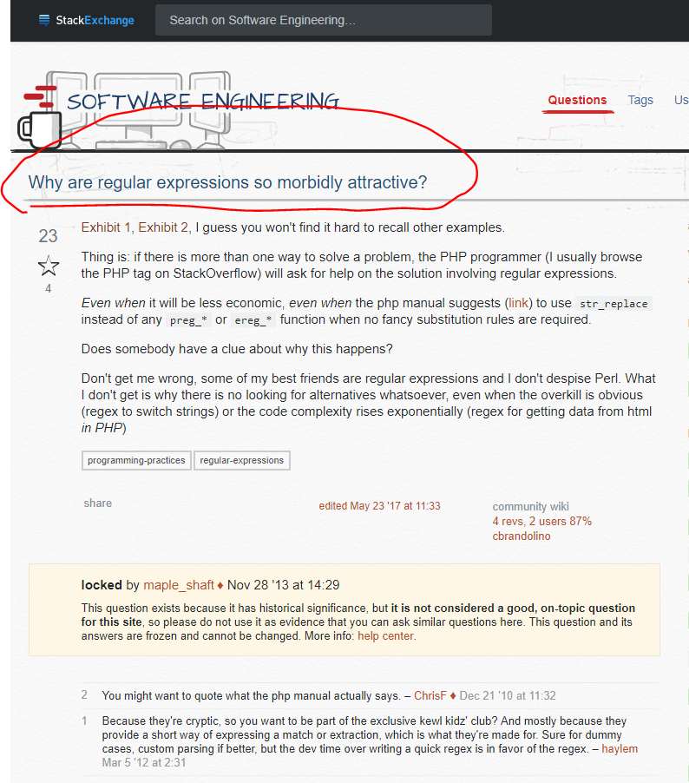
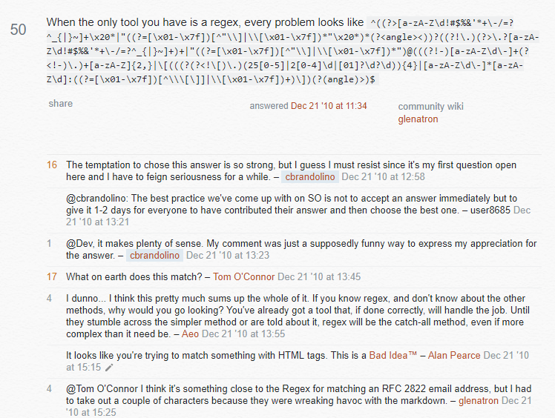

Slide 6
Now for some Regex Lessons
These examples come from regex101.com, a very useful testing tool
Open this site in a browser pls

Slide 7
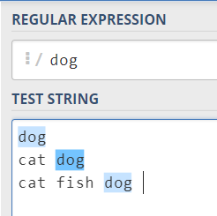
1. Regex can match just regular characters
Now go to https://regexone.com/ and do the first lesson

Slide 8
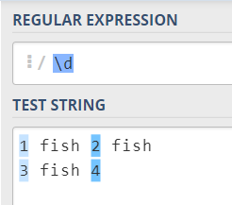
1.5 Regex also has special characters, using `\`
\d matches any digit 0-9
Now do https://regexone.com/lesson/letters_and_digits

Slide 9
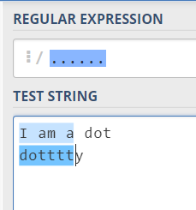
2. The Dot . (wildcard!)
. matches anything.
What if you only want to match a literal .
“Escape” it with \.
You can “escape” any otherwise-special character this way
Now do https://regexone.com/lesson/wildcards_dot

Slide 10
For your reference
1. Matching just regular old characters
1.5 Matching numbers with \d
2. The Dot .
3. Using square brackets [ ] to match specific characters
4. Excluding specific characters
5. Character ranges
6. Repeating characters (or groups of characters) with curly braces { }
7. Using * and + to match 0 or more or 1 or more respectively
.*
8. Making characters optional with ?
9. Matching whitespace
10. ^ and $ to match “beginning” and “end” of lines
11. Matching groups with parentheses ( )
12. Nested groups (don’t worry about this one)
13. More practice with groups
14. Either-or with the pipe | characters

Slide 11
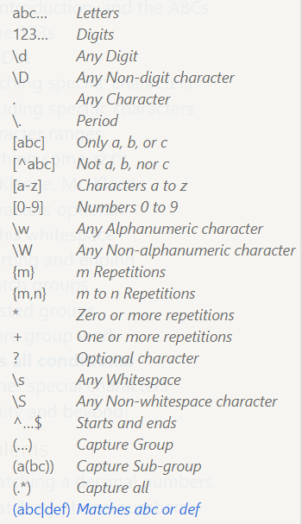
Let’s continue on with the lessons
You are only responsible for the content in the lessons (regex has more features than this)
Completing them is part of your small regex homework
Here is a handy reference ➔

Slide 12
Post-practice

Slide 13
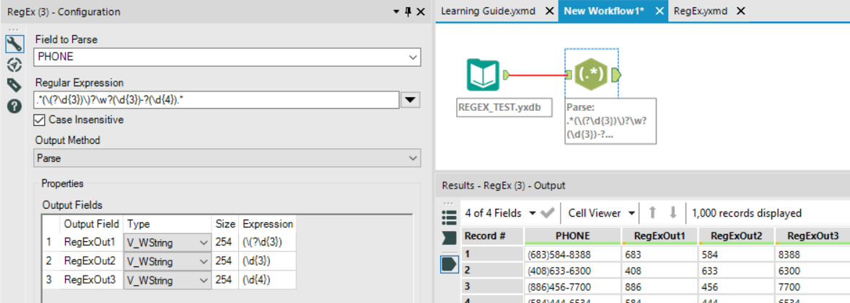
Alteryx can do Regex, too
Download REGEX_TEST.yxdb from canvas and load it into Alteryx
Using `Parse` mode, try to split a phone number into its three numeric parts

Slide 14
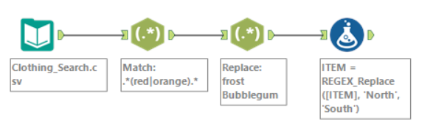
Alteryx can do Regex, too
Download Clothing_search.csv and load it into Alteryx
Do the following. With Regex Tool
Use `Match` mode to find all items either red or orange
Use `Replace` mode to swap out the color “Frost” for “Bubblegum”
Formula Tool can do it, too. Do this:
use function `REGEX_Replace` to swap out the string “North” with “South”
Try to figure out the tools on your own (use Help > Sample Workflows > Learn one tool at a time > Parse > Regex if you need to

Slide 15
If extra time… one more practice
Download “crime rates by metropolitan area 2016” from canvas. It shows crime rates for different areas in the US
Import it, using the `Highest Metro Murder Rates` sheet
We want to summarize the crime rates by state. To do that, we need to extract the state from the first column
Using Regex in `Parse` mode, extract the state
Just pretend rows with multi-states aren’t a problem (e.g., ignore “TN-MS-AR”)

Slide 16
For your convenience
Completed examples available on canvas, search for something like “04-eargle-regex-example” in the files area

